Slide 1
Strong Average-Case Circuit Lower Bounds from Non-trivial Derandomization
Lijie Chen
MIT
Hanlin Ren
IIIS, Tsinghua

Slide 2
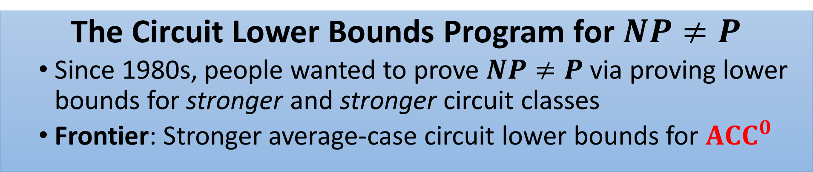
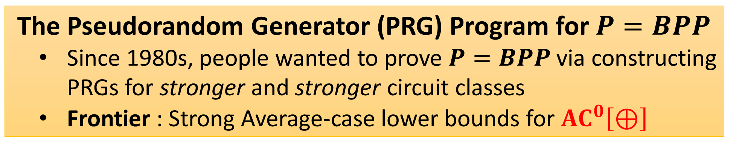
(Oversimplified) History and Motivation
The Circuit Lower Bounds Program for $NP≠P$
Since 1980s, people wanted to prove $NP≠P$ via proving lower bounds for stronger and stronger circuit classes
Frontier: Stronger average-case circuit lower bounds for $ACC^{0}$
The Pseudorandom Generator (PRG) Program for $P=BPP$
Since 1980s, people wanted to prove $P=BPP$ via constructing PRGs for stronger and stronger circuit classes
Frontier : Strong Average-case lower bounds for $AC^{0}\left[⊕\right]$
Notes:
TODO:dots

Slide 3

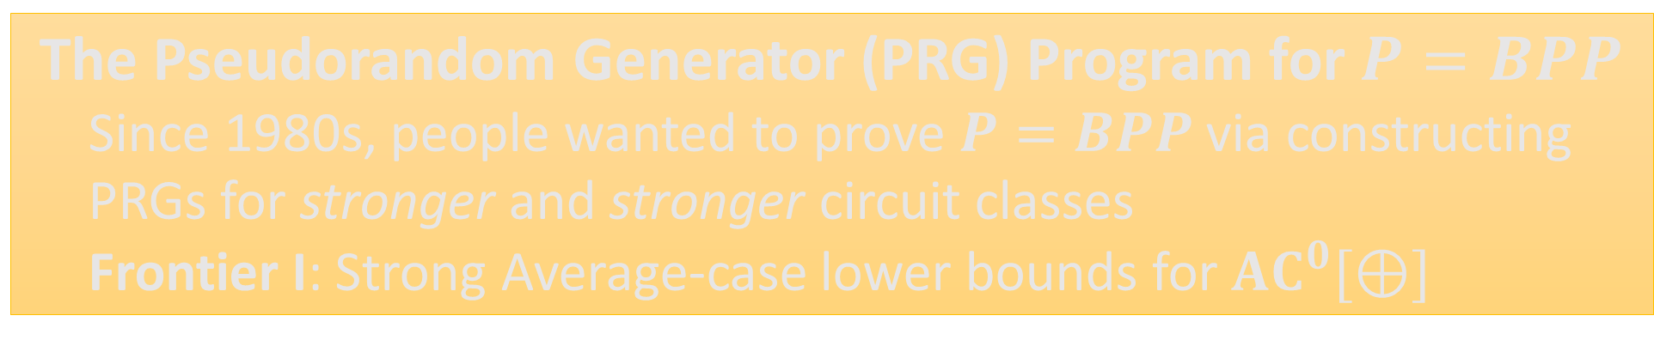
(Oversimplified) History and Motivation
The Circuit Lower Bounds Program for $NP≠P$
Since 1980s, people wanted to prove $NP≠P$ via proving lower bounds for stronger and stronger circuit classes
Frontier I: Stronger average-case circuit lower bounds for $ACC^{0}$
The Pseudorandom Generator (PRG) Program for $P=BPP$
Since 1980s, people wanted to prove $P=BPP$ via constructing PRGs for stronger and stronger circuit classes
Frontier I: Strong Average-case lower bounds for $AC^{0}[⊕]$
Notes:
TODO:dots

Slide 4

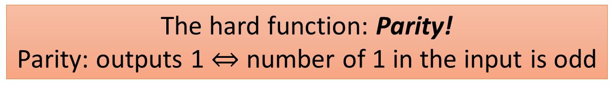
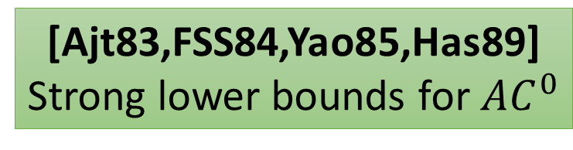
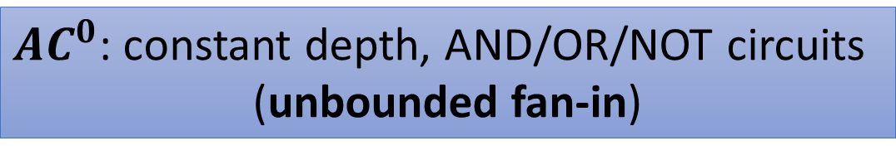
(Oversimplified) History: Part 1
The Circuit Lower Bounds Program for $NP≠P$
People wanted circuit lower bounds (and $P≠NP$), but now we know it is HARD…
But it seemed not that hard in 1980s
Quest at that time: understand the constant depth circuits first!
$AC^{0}$: constant depth, AND/OR/NOT circuits
(unbounded fan-in)
[Ajt83,FSS84,Yao85,Has89]
Strong lower bounds for $AC^{0}$
The hard function: Parity!
Parity: outputs 1 $⇔$ number of 1 in the input is odd

Slide 5
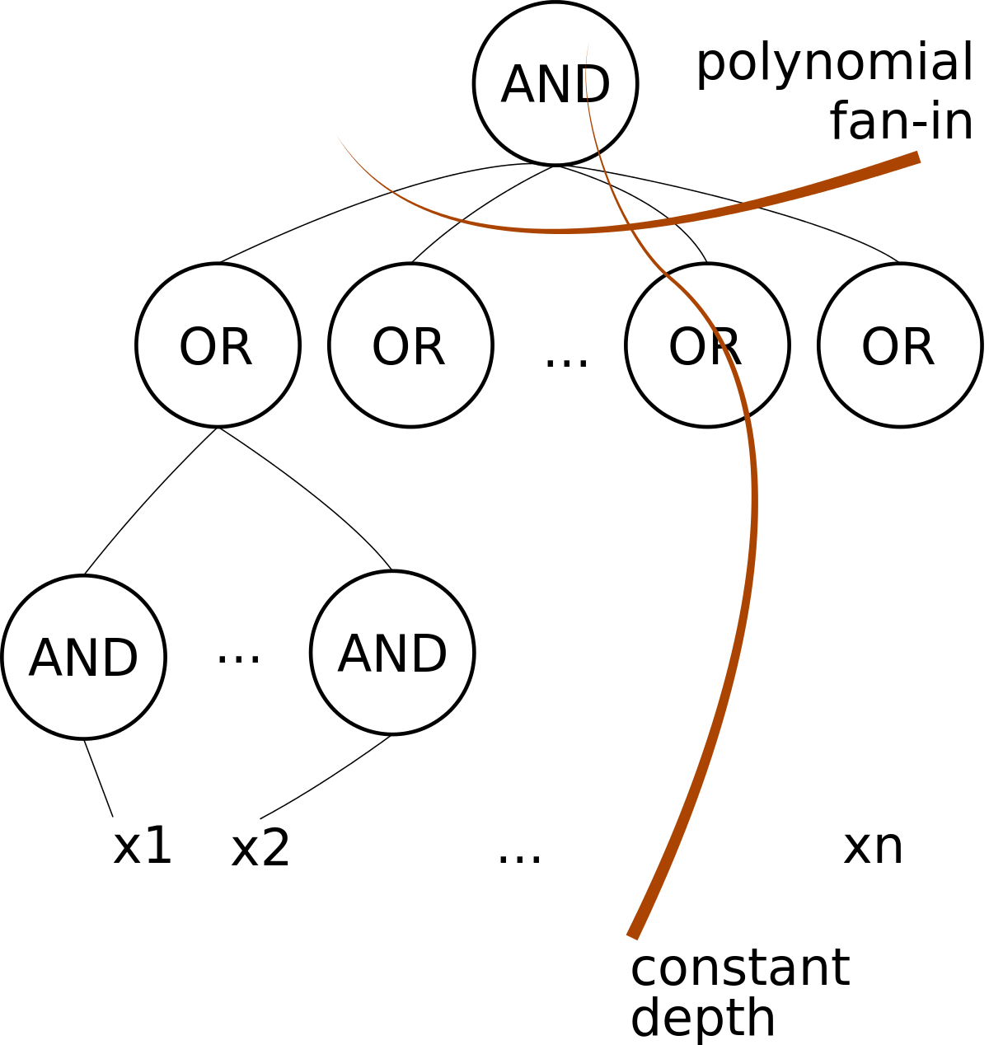

$AC^{0}$ Circuits
The Circuit Lower Bounds Program for $NP≠P$

Slide 6
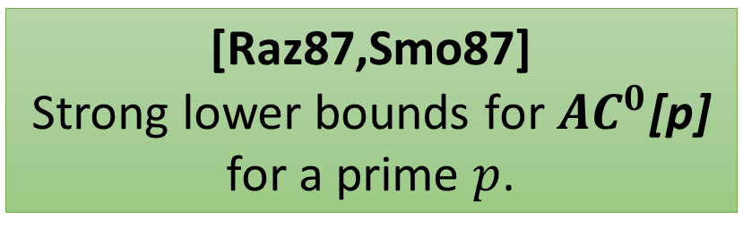
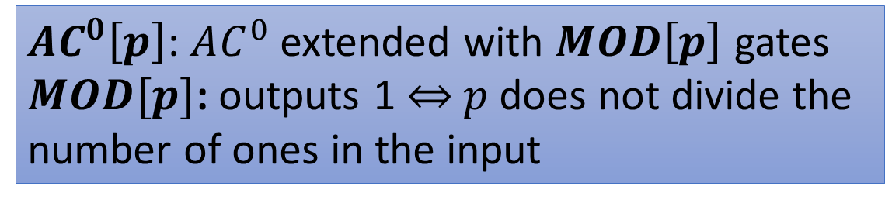
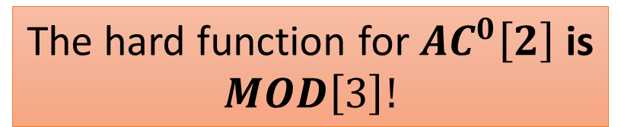
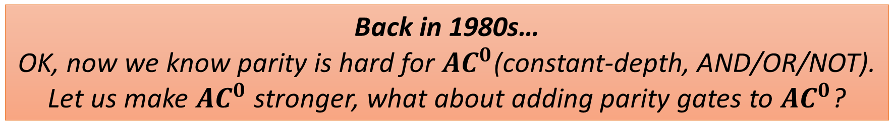
The Circuit Lower Bounds Program for $NP≠P$
(Oversimplified) History: Part 2
Back in 1980s…
OK, now we know parity is hard for $AC^{0}$(constant-depth, AND/OR/NOT).
Let us make $AC^{0}$ stronger, what about adding parity gates to $AC^{0}$?
Philosophy: strengthen the circuit class ``just a little bit’’ by adding the most
simple function it cannot compute as available gates.
Hopefully, we can get to general circuits very soon!
$AC^{0}\left[p\right]$: $AC^{0}$ extended with $MOD\left[p\right]$ gates
$MOD[p]$: outputs 1 $⇔$ $p$ does not divide the
number of ones in the input
[Raz87,Smo87]
Strong lower bounds for $AC^{0}$[p]
for a prime $p$.
The hard function for $AC^{0}\left[2\right]$ is
$$MOD\left[3\right]!$$

Slide 7
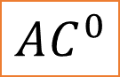
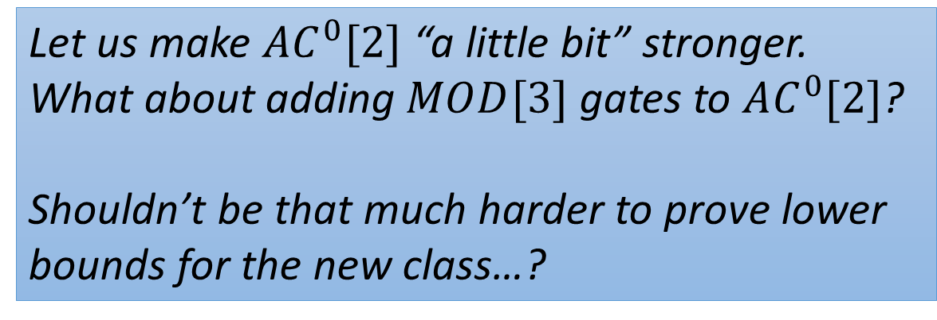
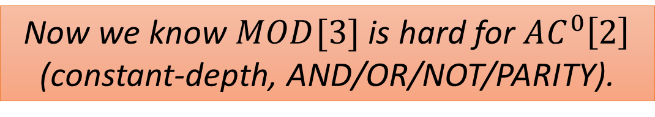
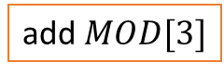
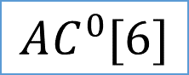
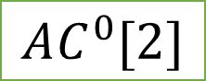
The Circuit Lower Bounds Program for $NP≠P$
(Oversimplified) History: Part 3
Back in 1980s…
Nice, so far everything has been very successful!
Now we know $MOD[3]$ is hard for $AC^{0}\left[2\right]$
(constant-depth, AND/OR/NOT/PARITY).
$$AC^{0}$$
add parity
$$AC^{0}[2]$$
Let us make $AC^{0}[2]$ “a little bit” stronger. What about adding $MOD[3]$ gates to $AC^{0}[2]$?
Shouldn’t be that much harder to prove lower bounds for the new class…?
add $MOD[3]$
$$AC^{0}[6]$$
Umm…

Slide 8

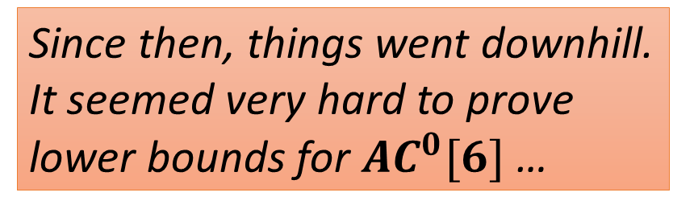
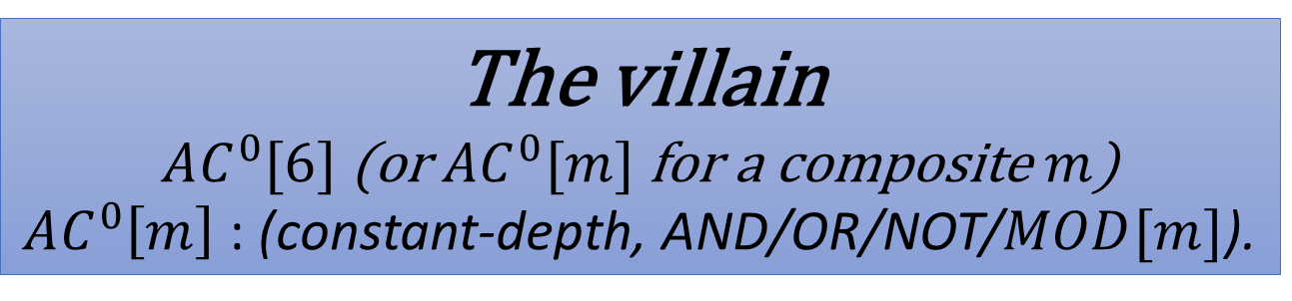
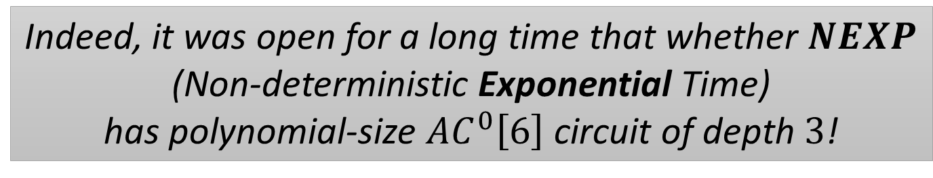
The Circuit Lower Bounds Program for $NP≠P$
(Oversimplified) History: Part 4
The villain
$AC^{0}[6]$ (or $AC^{0}[m]$ for a composite $m$)
$AC^{0}\left[m\right]$ : (constant-depth, AND/OR/NOT/$MOD[m]$).
Since then, things went downhill.
It seemed very hard to prove
lower bounds for $AC^{0}[6]$ …
Indeed, it was open for a long time that whether $NEXP$
(Non-deterministic Exponential Time)
has polynomial-size $AC^{0}\left[6\right]$ circuit of depth $3$!

Slide 9
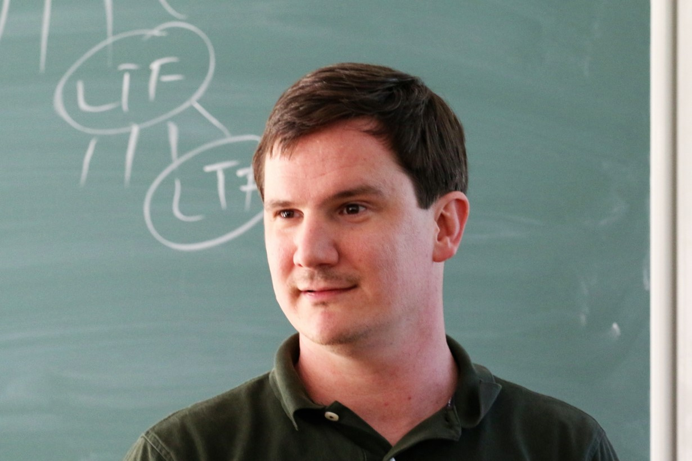

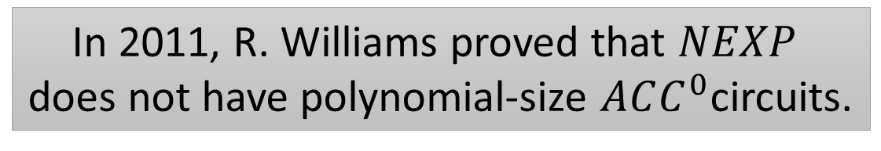
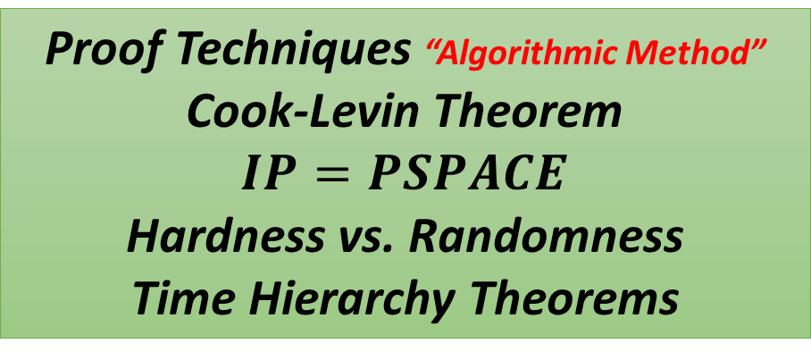
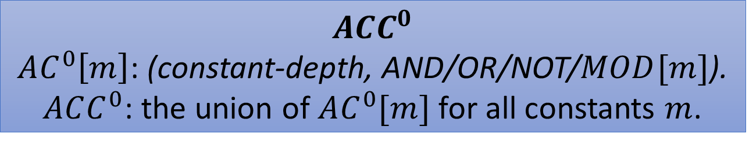
The Circuit Lower Bounds Program for $NP≠P$
NEXP $⊄$ $ACC^{0}$
$$ACC^{0}$$
$AC^{0}\left[m\right]$: (constant-depth, AND/OR/NOT/$MOD[m]$).
$ACC^{0}$: the union of $AC^{0}[m]$ for all constants $m$.
In 2011, R. Williams proved that $NEXP$
does not have polynomial-size $ACC^{0}$circuits.
Theoretical Importance of this result
Crossing all the “barriers”
Relativization
Algebrization
Natural Proofs
Proof Techniques “Algorithmic Method”
Cook-Levin Theorem
$$IP=PSPACE$$
Hardness vs. Randomness
Time Hierarchy Theorems

Slide 10
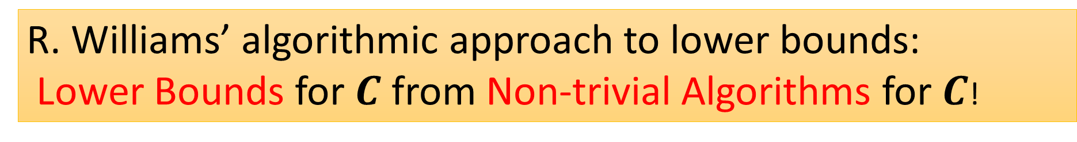
The Circuit Lower Bounds Program for $NP≠P$
Algorithmic Method
Proving Lower Bounds is a notoriously hard task
Why? You must argue that EVERY ALGORITHMS (including those we never thought of) does not work
Meanwhile, it seems we are much better at finding algorithms: Max Matching, Max-Flow, Linear Programming, FFT, Fast matrix multiplication, Dynamic Programming…
R. Williams’ algorithmic approach to lower bounds:
Lower Bounds for $C$ from Non-trivial Algorithms for $C$!

Slide 11
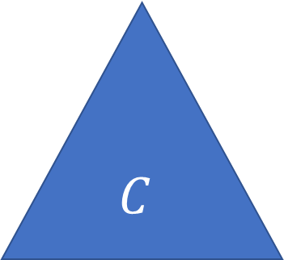


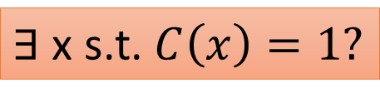
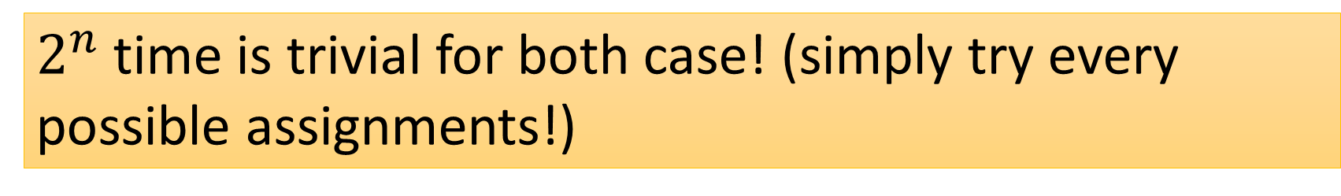
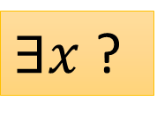
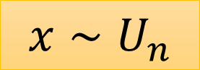

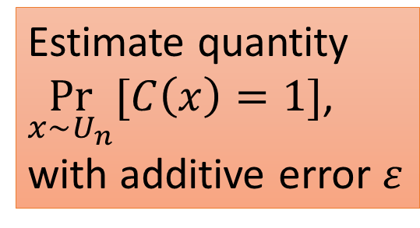
Algorithmic Questions
$C$-SAT
$C$-CAPP
$$C$$
$$C$$
Estimate quantity
$\underset{x∼U_{n}}{Pr}{[C\left(x\right)=1]}$,
with additive error $ε$
$2^{n}$ time is trivial for both case! (simply try every possible assignments!)
$∃$ x s.t. $C\left(x\right)=1?$
$∃x$ ?
$$x∼U_{n}$$
Notes:
Our notion for Non-trivial CAPP is slightly restrictive more several technical reasons…
Because we don’t want to afford a loss of the depth in the construction

Slide 12
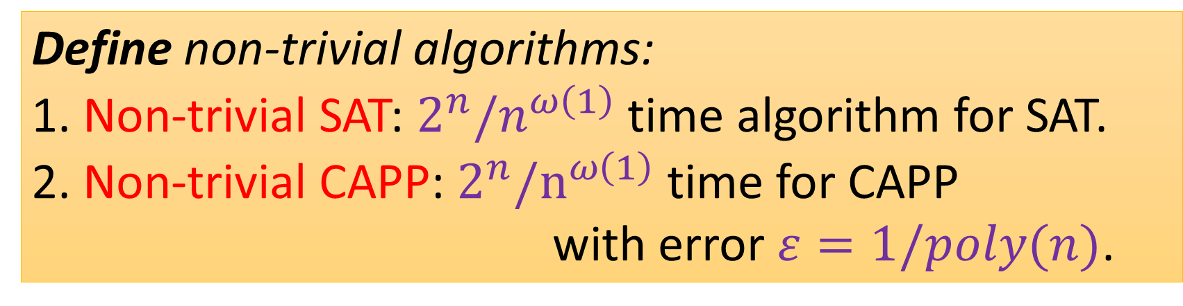
Algorithmic Questions
$C$-SAT
$C$-CAPP
Define non-trivial algorithms:
1. Non-trivial SAT: $2^{n}/n^{ω\left(1\right)}$ time algorithm for SAT.
2. Non-trivial CAPP: $2^{n}/n^{ω\left(1\right)}$ time for CAPP with error $ε=1/poly(n)$.
$$C$$
$$C$$
Estimate quantity
$\underset{x∼U_{n}}{Pr}{[C\left(x\right)=1]}$,
with additive error $ε$
$∃$ x s.t. $C\left(x\right)=1?$
$∃x$ ?
$$x∼U_{n}$$
Notes:
Our notion for Non-trivial CAPP is slightly restrictive more several technical reasons…
Because we don’t want to afford a loss of the depth in the construction

Slide 13
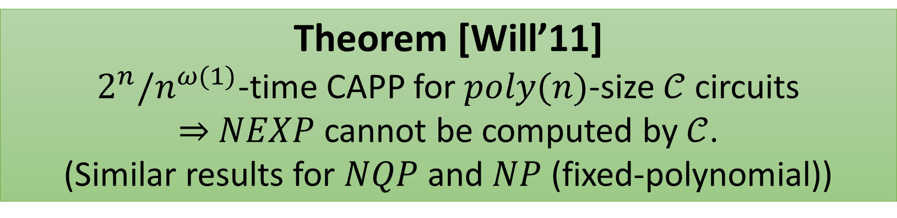
Previous Connection
Theorem [Will’11]
$2^{n}/n^{ω(1)}$-time CAPP for $poly(n)$-size $𝒞$ circuits $⇒$ $NEXP$ cannot be computed by $𝒞$.
(Similar results for $NQP$ and $NP$ (fixed-polynomial))
Notes:
Our notion for Non-trivial CAPP is slightly restrictive more several technical reasons…
Because we don’t want to afford a loss of the depth in the construction

Slide 14

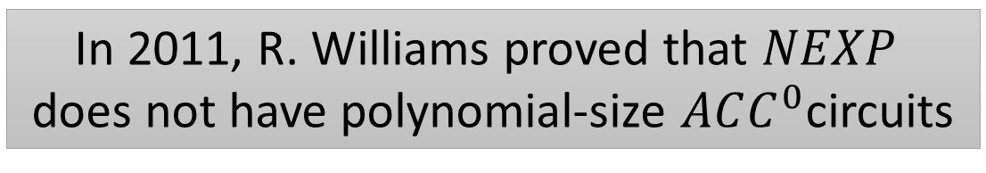
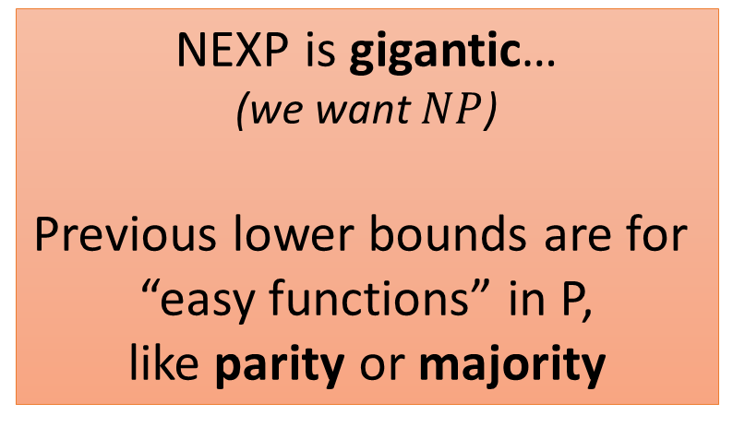
The Circuit Lower Bounds Program for $NP≠P$
NEXP $⊄$ $ACC^{0}$
In 2011, R. Williams proved that $NEXP$
does not have polynomial-size $ACC^{0}$circuits
A Big Breakthrough
Still, it has some drawbacks comparing to previous lower bounds
Only worst-case lower bounds
Previous lower bounds can often be
adapted to the average-case setting
Average-case lower bounds can
have more applications
NEXP is gigantic…
(we want $NP$)
Previous lower bounds are for
“easy functions” in P,
like parity or majority

Slide 15

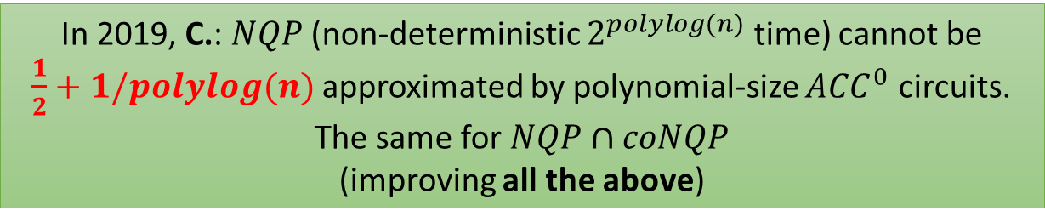
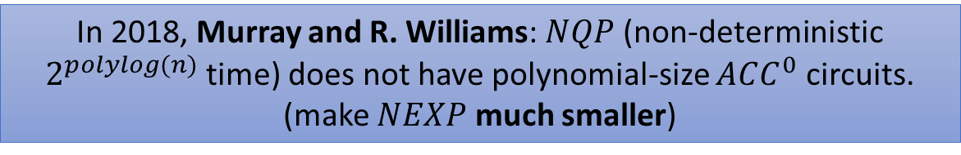
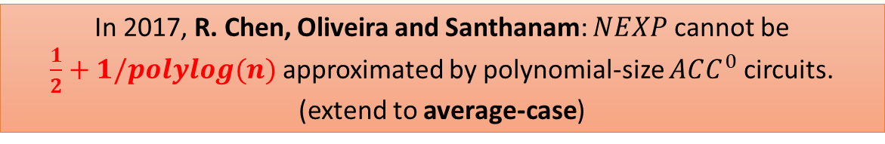
The Circuit Lower Bounds Program for $NP≠P$
Subsequent Developments
In 2012, R. Williams: $NEXP∩coNEXP$
does not have polynomial-size $ACC^{0}$circuits.
(make $NEXP$ a bit smaller)
In 2017, R. Chen, Oliveira and Santhanam: $NEXP$ cannot be
$\frac{1}{2}+1/polylog(n)$ approximated by polynomial-size $ACC^{0}$ circuits.
(extend to average-case)
Over the uniform
distribution
Can this be improved?
In 2018, Murray and R. Williams: $NQP$ (non-deterministic $2^{polylog(n)}$ time) does not have polynomial-size $ACC^{0}$ circuits.
(make $NEXP$ much smaller)
In 2019, C.: $NQP$ (non-deterministic $2^{polylog(n)}$ time) cannot be
$\frac{1}{2}+1/polylog(n)$ approximated by polynomial-size $ACC^{0}$ circuits. The same for $NQP∩coNQP$
(improving all the above)
Notes:
This Chen is not me!

Slide 16
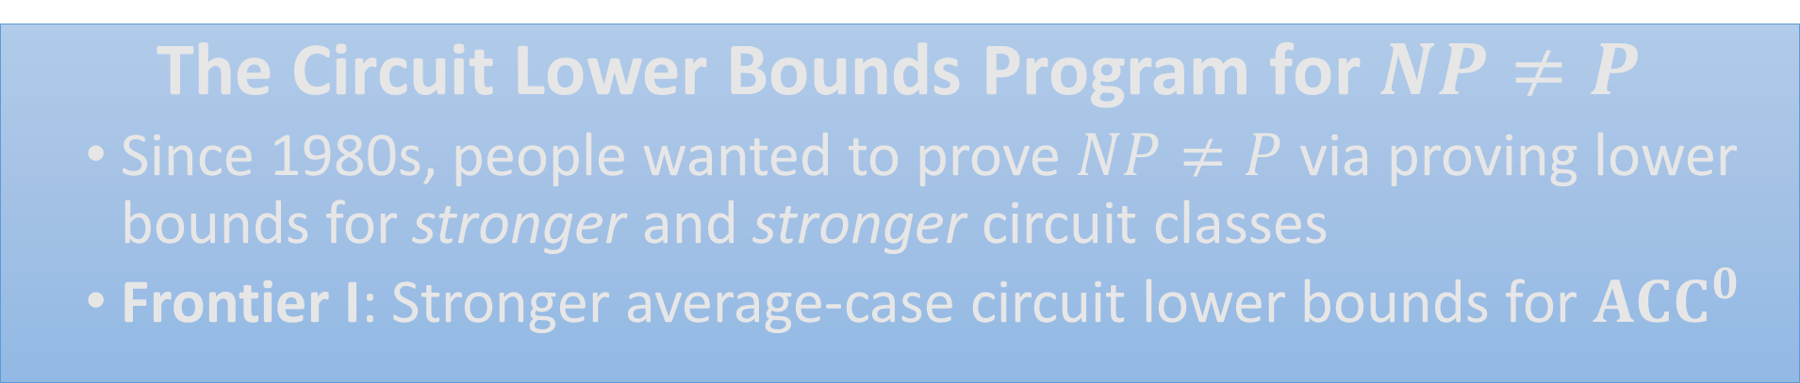
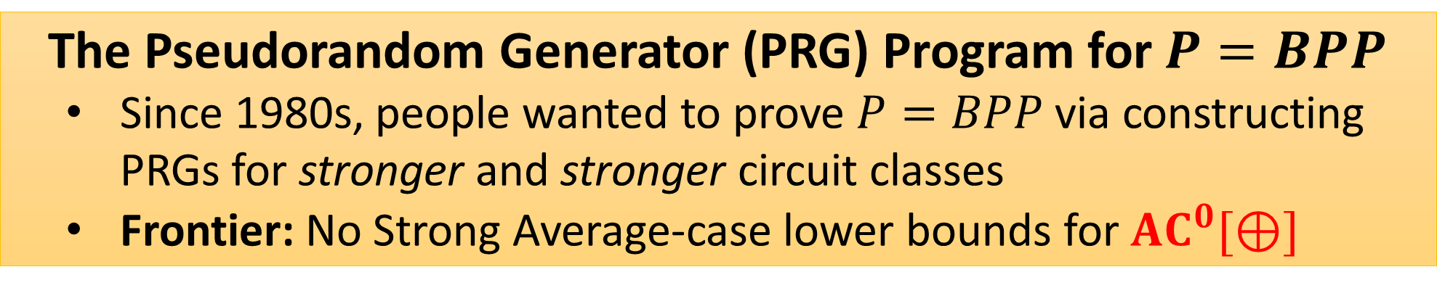
(Oversimplified) History and Motivation
The Circuit Lower Bounds Program for $NP≠P$
Since 1980s, people wanted to prove $NP≠P$ via proving lower bounds for stronger and stronger circuit classes
Frontier I: Stronger average-case circuit lower bounds for $ACC^{0}$
The Pseudorandom Generator (PRG) Program for $P=BPP$
Since 1980s, people wanted to prove $P=BPP$ via constructing PRGs for stronger and stronger circuit classes
Frontier: No Strong Average-case lower bounds for $AC^{0}[⊕]$
Notes:
TODO:dots

Slide 17
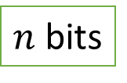
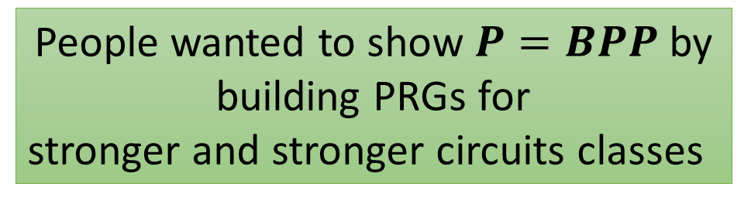

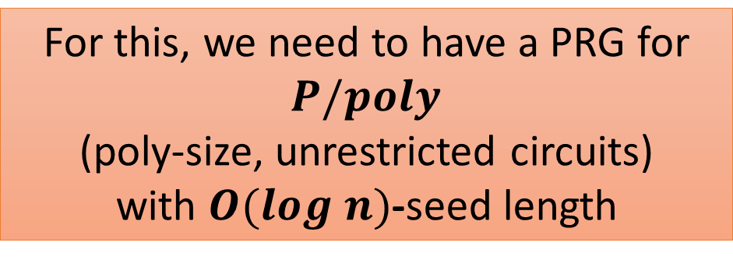

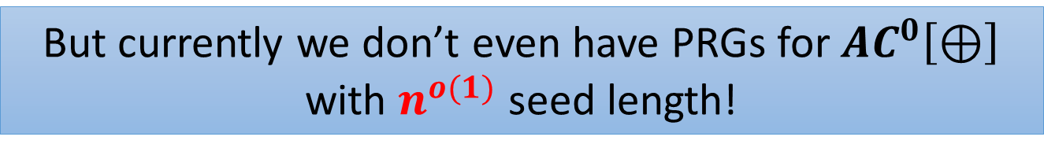
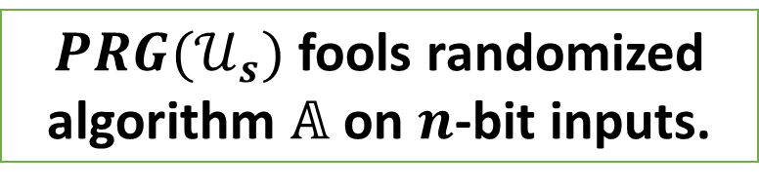
(Oversimplified) History
The Pseudorandom Generator Program for $P=BPP$
$PRG(𝒰_{s})$ fools randomized algorithm $𝔸$ on $n$-bit inputs.
PRG
$s$ bits
$n$ bits
$𝔸$ in $2^{s}$ deterministic time
For this, we need to have a PRG for $P/poly$
(poly-size, unrestricted circuits)
with $O(log n)$-seed length
People wanted to show $P=BPP$ by building PRGs for
stronger and stronger circuits classes
But currently we don’t even have PRGs for $AC^{0}\left[⊕\right]$ with $n^{o(1)}$ seed length!
Notes:
TODO: add the best we have
TODO: ``currently’’ -> ``before our results’’?

Slide 18
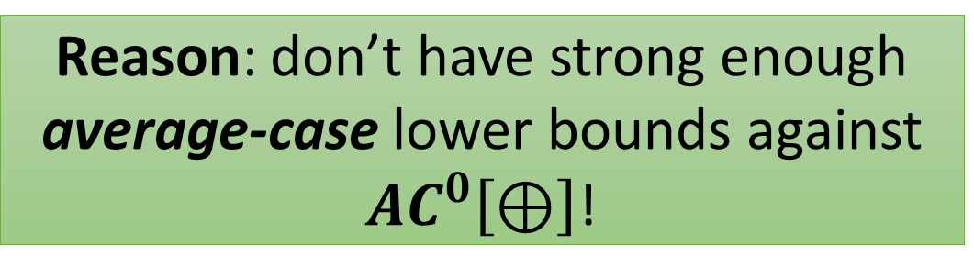

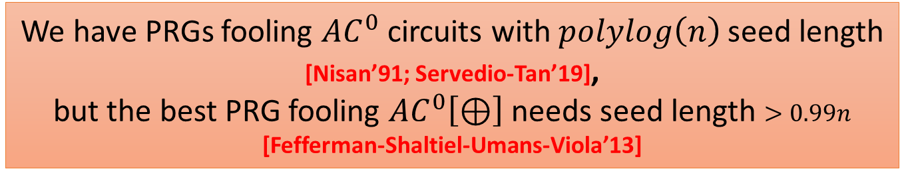
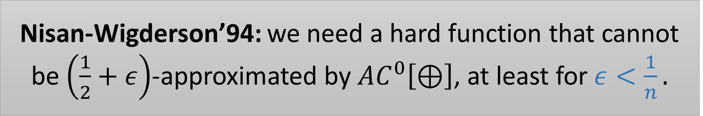
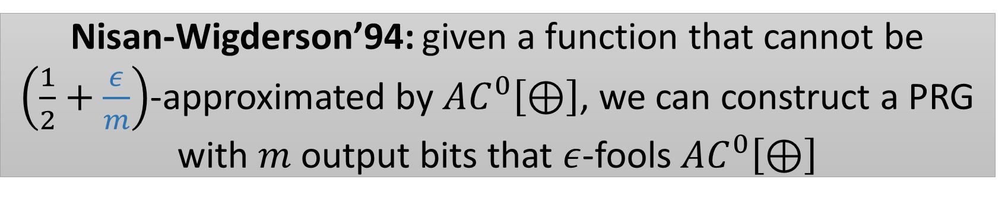
Pseudorandom Generators fooling $AC^{0}\left[⊕\right]$?
The Pseudorandom Generator Program for $P=BPP$
We have PRGs fooling $AC^{0}$ circuits with $polylog\left(n\right)$ seed length [Nisan’91; Servedio-Tan’19],
but the best PRG fooling $AC^{0}\left[⊕\right]$ needs seed length $>0.99n$ [Fefferman-Shaltiel-Umans-Viola’13]
Reason: don’t have strong enough average-case lower bounds against $AC^{0}\left[⊕\right]$!
Nisan-Wigderson’94: we need a hard function that cannot be $\left(\frac{1}{2}+ε\right)$-approximated by $AC^{0}\left[⊕\right]$, at least for $ε<\frac{1}{n}.$
Nisan-Wigderson’94: given a function that cannot be $\left(\frac{1}{2}+\frac{ε}{m}\right)$-approximated by $AC^{0}\left[⊕\right]$, we can construct a PRG with $m$ output bits that $ε$-fools $AC^{0}\left[⊕\right]$

Slide 19
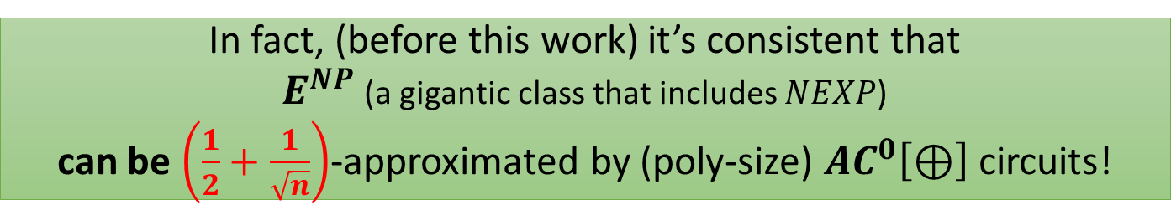




Pseudorandom Generators fooling $AC^{0}\left[⊕\right]$?
The Pseudorandom Generator Program for $P=BPP$
State-of-the-art average-case lower bound:
MAJORITY cannot be $\left(\frac{1}{2}+n^{−0.49}\right)$-approximated by $AC^{0}\left[⊕\right]$ circuits.
This lower bound does not yield PRGs!
In fact, (before this work) it’s consistent that
$E^{NP}$ (a gigantic class that includes $NEXP$)
can be $\left(\frac{1}{2}+\frac{1}{\sqrt{n}}\right)$-approximated by (poly-size) $AC^{0}\left[⊕\right]$ circuits!
It’s also consistent that $E^{NP}$ can be $\left(\frac{1}{2}+\frac{1}{\sqrt{n}}\right)$-approximated by
$\left(\log{n}\right)$-degree $𝔽_{2}$-polynomials.
Nisan-Wigderson’94: we need a hard function that is not $\left(\frac{1}{2}+ε\right)$-approximated by $AC^{0}\left[⊕\right]$, at least for $ε<\frac{1}{n}.$

Slide 20




This Work: Strong Average-Case Lower Bounds for $ACC^{0}$
Improved the $\frac{1}{2}+1/polylog(n)$ result in [C.’19]
NQP (non-deterministic $2^{polylog(n)}$ time) cannot be $\left(\frac{1}{2}+1/poly(n)\right)$-approximated by polynomial-size $ACC^{0}$ circuits.
The same holds for $NQP∩coNQP$
Surpassed the
$\frac{1}{2}+1/\sqrt{n}$-barrier for $AC^{0}[⊕]$

Slide 21



Strong Average-Case Lower Bounds From Non-trivial Derandomization
It is in $P$ under the widely believed conjecture promise$P=promiseBPP$
CIRCUIT ACCEPTANCE PROBABILITY PROBLEM (CAPP)
Given a circuit $C$ on $n$ bits of size $S$, estimate
$$\underset{x}{Pr}\left[C\left(x\right)=1\right]$$
within an additive error of $1/S$
Theorem
$2^{n}/n^{ω(1)}$-time CAPP for $poly(n)$-size $𝒞$ circuits $⇒$ $NEXP$ cannot be $\left(\frac{1}{2}+1/poly(n)\right)$-approximated by $𝒞$.
(Similar results for $NQP$ and $NP$ (fixed-polynomial))

Slide 22








How this Work relies on recent works
[Wil’10]
Conditional i.o. NPRG for $P/poly$
[Wil’11]
$2^{n−n^{ε}}$-time algorithm for CAPP of $2^{n−n^{ε}}$-size $ACC^{0}$ circuits
Today’s Plan
Instead of giving you a semester-long lecture about all the ideas involved,
I am going to focus on one interesting ingredient.
[Wil’13] ([Wil’11])
Conditional a.e. MA lower bounds, and $NEXP⊄ACC^{0}$.
[MW’18]
a.a.e. MA lower bounds, and
$NQP⊄ACC^{0}$.
[C.W’19]
CAPP for approximate sum of $ACC^{0}$
PCP of Proximity pushing
evaluations to oracles
[C.’19]
Conditional i.o. NPRG for $NC^{1}$
a.a.e. MA average-case lower bounds,
Conditional collapse from $NC^{1}$ to $ACC^{0}$
$NQP$ can’t be $\frac{1}{2}+1/polylog\left(n\right)$ approximated by $ACC^{0}$
[C.R’20]
Conditional i.o. NPRG for $NC^{1}$
Conditional collapse from $NC^{1}$ to approx. sum of $ACC^{0}$
$NQP$ can’t be $\frac{1}{2}+1/poly\left(n\right)$
approximated by $ACC^{0}$
Notes:
Explain what is i.o.
Explain why i.o. Non-deterministic PRG can be used to i.o. derandomize an MA algorithm

Slide 23

Today’s Plan
Review of the framework of Hardness Amplification
The proof of [Chen-Oliveira-Santhanam]
Approximate Linear Sum, and the Non-Blackbox Hardness Amplification, with two simpler proofs:
$NEXP$ can’t be $\frac{1}{2}+1/poly(n)$ approximated by $ACC^{0}$.
$NQP$ does not have $poly(n)$-size $MAJ∘ACC^{0}$ circuits.
Quick Overview of the whole proof
(Intended as an invitation to read the paper!)
Notes:
Explain what is i.o.
Explain why i.o. Non-deterministic PRG can be used to i.o. derandomize an MA algorithm

Slide 24
Why Average-Case Lower Bounds are Harder?
[MW’18], [Wil’11]’s Worst-Case Lower Bounds
All rely on the so called easy-witness lemma
A famous result in complexity! But not in this talk as we don’t need it
Such a lemma is only known in the worst-case!
The old proofs complete breaks in the average-case!

Slide 25




Chen-Oliveira-Santhanam’s approach:
NEXP is average-case hard for $ACC^{0}$
Question
How to amplify a worst-case lower bound into an average-case lower bound?
[COS’18]: We can use such a big weapon:
Worst-case to Average-case Hardness Amplification
Worst-case lower bound for
$$ACC^{0}$$
Average-case lower bound for $ACC^{0}$
Notes:
Say some intuition

Slide 26


Worst-case to Average-case Hardness Amplification: Abstract Setup
Amplifier: Amp
Reduction: Red
$L→Amp(L)$:
for any function $h$ $\left(\frac{1}{2}+ε\right)$-approximates $Amp(L)$,
$Red^{h}\left(x\right)=L\left(x\right)$ for all $x$
If $L$ cannot be worst-case computed by $Red^{ACC^{0}}$,
then $Amp(L)$ cannot be approximated by $ACC^{0}$!
Notes:
Say some intuition

Slide 27





Chen-Oliveira-Santhanam’s approach:
NEXP is average-case hard for $ACC^{0}$
Reduction:
Red can be implemented as an $AC^{0} circuit$
Amplifier: Amp
takes $2^{O(n)}$ time
$$ε=1/polylog(n)$$
$L→Amp(L)$:
for any function $h$ $\left(\frac{1}{2}+ε\right)$-approximates $Amp(L)$,
$Red^{h}≡L$.
If $L$ cannot be worst-case computed by $ACC^{0}$,
Then $Amp(L)$ cannot be $(\frac{1}{2}+1/polylog(n))$-approximated by $ACC^{0}$!
Notes:
Say some intuition

Slide 28





So why not push forward?
Reduction:
Red can be implemented as an $A{CC}^{0} circuit$?
Amplifier: Amp
takes $2^{O(n)}$ time
$$ε=1/n^{100}$$
$L→Amp(L)$:
for any function $h$ $\left(\frac{1}{2}+ε\right)$-approximates $Amp(L)$,
$Red^{h}≡L$.
[SV’10, Grinberg-Shaltiel-Viola’18] When $ε=1/n^{100}$, $Red$ must be at least as powerful as Majority!
Would require a $MAJ∘ACC^{0}$ lower bound to start with!
Notes:
Say some intuition

Slide 29


Summary
We want to ``convert’’ worst-case lower bounds against $ACC^{0}$
into strong average-case lower bounds
[SV10, GSV18]
If we use ``black-box’’ transformation.
It seems that we need to show worst-case lower bounds for
$$MAJ∘ACC^{0}$$
Can we avoid this barrier?
Notes:
Say some intuition

Slide 30
Today’s Plan
Review of the framework of Hardness Amplification
The proof of [Chen-Oliveira-Santhanam]
Approximate Linear Sum, and the Non-Blackbox Hardness Amplification, with two simpler proofs:
$NEXP$ can’t be $\frac{1}{2}+1/poly(n)$ approximated by $ACC^{0}$.
$NQP$ does not have $poly(n)$-size $MAJ∘ACC^{0}$ circuits.
Quick Overview of the whole proof
(Intended as an invitation to read the paper!)
Notes:
Explain what is i.o.
Explain why i.o. Non-deterministic PRG can be used to i.o. derandomize an MA algorithm

Slide 31

Intuition
The limitation of [GSV, SV] is talking about black-box hardness amplification
which works for ALL functions $f$
How to avoid the barrier?
Use non-black box
hardness amplification
Use special property of
functions f
Notes:
Say some intuition

Slide 32














Approximate Sum
Let $𝒞$ be a circuit class. A Linear Sum of $𝒞$ is
$$L=α_{1}⋅C_{1}+α_{2}⋅C_{2}+…+α_{m}⋅C_{m}$$
where $α_{i}∈ℝ$, and $C_{i}∈𝒞$.
$$\left[−ε,ε\right]$$
if $F\left(x\right)=0$
$$\left[1−ε,1+ε\right]$$
if$F\left(x\right)=1$
We say $F:{\left\{0,1\right\}}^{n}→\{0,1\}$ is an approximate (linear) sum of $𝒞$, if there is an $L$ as above such that
$\left|L\left(x\right)−F\left(x\right)\right|≤ε$ for all $x$.
$$∑$$
$$α_{1}$$
$$α_{2}$$
$$⋯$$
$$α_{m}$$
$$C_{1}$$
$$C_{2}$$
$$⋯$$
$$C_{m}$$
For example, a function $F:{\left\{0,1\right\}}^{n}→\{0,1\}$, has approximate degree $d$, iff it is an approximate linear sum of $AND$ functions on $d$ bits.
Notes:
Cite the relevant paper
Yellow part: Cor
Maybe write the Lemma on the blackboard, so that people will understand.

Slide 33




Why is Approximate Sum better than MAJ?
With this observation
[C.-Williams]: nontrivial derand. algorithm for $ACC^{0}$ $⇒$ nontrivial derand. of approximate sum of $ACC^{0}$ $⇒$ $NQP$ cannot be computed by an approximate sum of $ACC^{0}$
Approximate Sum preserves algorithms!
Given an $ε$-approximate linear sum of $𝒞$ circuits
$$L=∑α_{i}⋅C_{i}$$
for a Boolean function $F$,
$𝔼\left[L\left(x\right)\right]=∑α_{i}⋅𝔼[C_{i}(x)]$ is $ε$-close to $𝔼[F(x)]$.
Most importantly, we know how to prove
worst-case lower bounds for approximate linear sum of $ACC^{0}$!
Unlike $MAJ∘ACC^{0}$!
That is, faster algorithms for computing $𝔼[C_{i}(x)]$ implies faster algorithms for estimating $𝔼\left[F\left(x\right)\right].$

Slide 34

A non-black-box Hardness Amplification Theorem
$NE$ cannot be computed by
approximate sum of $ACC^{0}$ in the worst-case
NE cannot be $\frac{1}{2}+\frac{1}{poly\left(n\right)}−$approximated by $ACC^{0}$ circuits
Notes:
Say some intuition

Slide 35



Error Correction with Approximate Sum
Idea: Random Self-Reducibility
We say a language $L$ is random reducible. If there is an error corrector $D$ such that, if $C$ computes $L$ on a $\left(\frac{1}{2}+ε\right)$-fraction of inputs, then $D^{C}$ computes $L$ exactly.
Lemma
There is an $NC^{1}$-hard language $L$ with an approximate sum error corrector!
(From Cryptography in $NC^{0}$
[Applebaum-Ishai-Kushilevitz])
Cor
If $L$ can be $\left(\frac{1}{2}+n^{−k}\right)$-approximated by $ACC^{0}.$
Then $NC^{1}$ collapses to Approximate Sum of $ACC^{0}$
Notes:
Cite the relevant paper
Yellow part: Cor
Maybe write the Lemma on the blackboard, so that people will understand.

Slide 36




A non-black-box Hardness Amplification Theorem
$NE$ cannot be computed by
approximate sum of $ACC^{0}$ in the worst-case
Case I
$L$ cannot be $\frac{1}{2}+1/poly(n)$-approximated by $ACC^{0}$
Clearly NE also can’t!
NE cannot be $\frac{1}{2}+\frac{1}{poly\left(n\right)}−$
approximated by $ACC^{0}$ circuits
Case II
$L$ can be $\frac{1}{2}+1/poly(n)$-approximated by $ACC^{0}$
$NC^{1}$ collapses to approximate sum of $ACC^{0}$
$NE$ not in $NC^{1}$!
Therefore NE cannot be $\frac{1}{2}+1/poly(n)$ approximated by $NC^{1}$!
Notes:
Go slowly at this slide

Slide 37
Technical ingredients from Crypto in $NC^{0}$
Only need to know that $⊕L$ is between $NC^{1}$ and $P$
There are two $⊕L$-complete languages $A,B$ such that
$A$ has a single-query randomized reduction to $B$,
where the queried input to $B$ distributes uniformly.
The Randomized Reduction
On an input $x∈^{?}A$:
Output an input $y∈^{?}B$ and a bit $b$
$y=y(x,r)$ is uniformly distributed
$b=b(x,r)$ indicates whether we should flip the answer, i.e. $A\left(x\right)=B\left(y\right) XOR b$
Moreover, both y and b are projections of $x$ when $r$ is fixed.
rand.
reduction
$$y$$
$$B$$
$$B(y)$$
XOR
$$x$$
$$A(x)$$
$$b$$
Notes:
mention that both reductions are “easy” in the sense that they are projections.
(two reductions: A,B are complete for parity L, and A reduces to B)
Need to edit this slide

Slide 38

Error Correction with Approximate Sum
rand.
reduction
$$y$$
$$B$$
$$B(y)$$
XOR
$$x$$
$$A(x)$$
$$b$$
For all $x,r$, $A\left(x\right)=B\left(y\left(x,r\right)\right)⊕b(x,r)$
If there is an $ACC^{0}$ circuit $D$ that $\left(\frac{1}{2}+ε\right)$-approximates $B.$
$E\left(x,r\right)≔D\left(y\left(x,r\right)\right)⊕b(x,r)$.
$E\left(x,r\right)=A(x)$ if and only if $D\left(y\left(x,r\right)\right)=B(y(x,r))$.
$$∀x,\underset{r}{Pr}\left[E\left(x,r\right)=A\left(x\right)\right]=\underset{r}{Pr}[D\left(y\left(x,r\right)\right)=B(y(x,r))] =\frac{1}{2}+ε$$
Independent of $x$!
Notes:
The “B gate” becomes blue; think of it gets corrupted and is only correct wp ½+eps;
It’s crucial that the “>=“ sign is actually an “=“ sign
Need to edit thisslide

Slide 39


Error Correction with Approximate Sum
$$∀x,\underset{r}{Pr}\left[E\left(x,r\right)=A\left(x\right)\right]=\frac{1}{2}+ε$$
The idea: take $t=poly(n,1/ε)$ i.i.d. samples $r_{1},r_{2},…,r_{t}$ and take average.
$$\frac{1}{t}⋅\sum_{i=1}^{t}{E(x,r_{i})}$$
If $A\left(x\right)=0$, then the expected average is $\frac{1}{2}−ε$
If $A\left(x\right)=1$, then the expected average is $\frac{1}{2}+ε$
If $A\left(x\right)=0$, then average $∈\left(\frac{1}{2}−1.01ε,\frac{1}{2}−0.99ε\right)$
If $A\left(x\right)=1$, then average $∈\left(\frac{1}{2}+0.99ε,\frac{1}{2}+1.01ε\right)$
If $B$ can be $\left(\frac{1}{2}+n^{−k}\right)$-approximated by $ACC^{0}$,
then (as $A$ is $NC^{1}$-hard), $NC^{1}$ collapses to Approximate Sum of $ACC^{0}$
Chernoff bound $⇒$ when $t=poly(n,1/ε)$, actual average is within expected average $±0.01ε$ whp
Use scaling to make a valid approx. sum circuit
Notes:
Need to edit this slide

Slide 40




A quick proof of $NQP$ not in $MAJ∘ACC^{0}$
1. If $NQP$ can be $\left(\frac{1}{2}+n^{−k}\right)$-approximated by $ACC^{0}$, then $NC^{1}$ collapses to approximate sum of $ACC^{0}$.
2. [C. and Williams, 2019]: $NQP$ is not in approximate sum of $ACC^{0}$. Hence, $NQP$ is not in $NC^{1}$ (also not in $MAJ∘ACC^{0}$).
3. If $NQP$ cannot be $\left(\frac{1}{2}+n^{−k}\right)$-approximated by $ACC^{0}$, then $NQP$ cannot be computed by $MAJ∘ACC^{0}$.
(The Discriminator Lemma)
Notes:
Should write the majority of ACC lower bound…

Slide 41
Today’s Plan
Review of the framework of Hardness Amplification
The proof of [Chen-Oliveira-Santhanam]
Approximate Linear Sum, and the Non-Blackbox Hardness Amplification, with two simpler proofs:
$NEXP$ can’t be $\frac{1}{2}+1/poly(n)$ approximated by $ACC^{0}$.
$NQP$ does not have $poly(n)$-size $MAJ∘ACC^{0}$ circuits.
Quick Overview of the whole proof
(Intended as an invitation to read the paper!)
Notes:
Explain what is i.o.
Explain why i.o. Non-deterministic PRG can be used to i.o. derandomize an MA algorithm

Slide 42



NPRG and Derandomization of MA
MA Algorithm
(NP with a randomized verifier!)
Given an input $x$, guess some witness $y$, toss some coins $r$.
$x∈L⇒∃y\underset{r}{Pr}\left[A\left(x,y,r\right)=1\right]≥2/3$;
$x∉L⇒∀y\underset{r}{Pr}\left[A\left(x,y,r\right)=1\right]≤1/3$.
Nondeterministic PRG
Given input $1^{n}$, guess a witness $w$ first.
either rejects w and STOP,
or takes a seed and computes a PRG
Derandomization of MA with NPRG
We can apply NPRG to derandomize MA to NP!
Given input $x$ ($\left|x\right|=n$), we guess both $y$ and $w$, if NPRG accepts $w$, use it to estimate $\underset{r}{Pr}{[A\left(x,y,r\right)=1]}$! (and accept only if $≥1/2$).
Notes:
Explain what is i.o.
Explain why i.o. Non-deterministic PRG can be used to i.o. derandomize an MA algorithm

Slide 43



[C.’19]’s Approach in Three Steps
Step I: (Conditional Simulation)
Assuming $NQP$ can be $0.99$-approximated by $ACC^{0}$, $NC^{1}$ can be simulated by $ACC^{0}$.
Step II: (An NPRG for $NC^{1}$)
Step I together with a non-trivial derandomization algorithm for $ACC^{0}$ implies a $polylog(n)$-seed length NPRG for $NC^{1}$.
Step III: (The Lower Bound)
Prove that there is a language $L$ in $MAQP$ such that $L$ cannot be $0.99$-approximated by $NC^{1}$. Apply NPRG of Step II to derandomize $L$ in $NQP$. Contradiction!

Slide 44





The Bottleneck of [C.’19]
Step I (?): (Conditional Simulation)
Assuming $NQP$ can be $(\frac{1}{2}+n^{−k})$-approximated by $ACC^{0}$, $NC^{1}$ can be simulated by $ACC^{0}$?
Now, suppose we want to prove $NQP$ cannot be $\left(\frac{1}{2}+n^{−k}\right)$-approximated by $ACC^{0}$ instead, which steps break?
not affected!
Step II: (An NPRG for $NC^{1}$)
Step I together with a non-trivial derandomization algorithm for $ACC^{0}$ implies a $polylog(n)$-seed length NPRG for $NC^{1}$.
The problem is Step I!
Step III seems to only give an 0.99-inapproximability bound. But it is indeed against $NC^{1}$. We can use XOR Lemma to show $NQP$ cannot be $\left(\frac{1}{2}+n^{−k}\right)$-approximated by $ACC^{0}$ easily.
Step III: (The Lower Bound)
Prove that there is a language $L$ in $MAQP$ such that $L$ cannot be $0.99$-approximated by $NC^{1}$. Apply NPRG of Step II to derandomize $L$ in $NQP$. Contradiction!
Notes:
Recall Step I when the black box pop up

Slide 45




Towards NQP Average-case Lower Bounds Updated Three Steps
Step I’: (Conditional Simulation)
Assuming $NQP$ can be $\left(\frac{1}{2}+n^{−k}\right)$-approximated by $ACC^{0}$, $NC^{1}$ can be simulated by an approximate sum of $ACC^{0}$.
Involves use of PCP of Proximity!
See the paper!
Step II’: (An NPRG for $NC^{1}$)
Step I’ together with a non-trivial derandomization algorithm for $ACC^{0}$ implies a $polylog(n)$-seed length NPRG for $NC^{1}$.
Step III’: (The Lower Bound)
Prove that there is a language $L$ in $MAQP$ such that $L$ cannot be $\left(\frac{1}{2}+n^{−k}\right)$-approximated by $NC^{1}$. Apply NPRG of Step II’ to derandomize $L$ in $NQP$. Contradiction!
Notes:
It is clearly to say NC^1 can be simulated by xyz

Slide 46


Conclusion
(Technical Take-home Message) Approximate Linear Sum is Both Weak and Strong Weak: Non-trivial Derand of $𝒞$ $⇒$ Non-trivial Derand of Approx. Sum of $𝒞$ (Preserve Algorithms)
Strong: Can do non-trivial error corrections!
(Conceptual Take-home Message)
Algorithms for $𝒞$ (a weaker class) can indeed imply lower bounds for $MAJ∘𝒞$ (a stronger class)!
Notes:
It is clearly to say NC^1 can be simulated by xyz

Slide 47








Extending the Conceptual Take-home Message
Open Questions
Non-trivial
Lower Bounds for
We showed
CAPP for $𝒞$
$$MAJ∘𝒞$$
Conjectured by [Vyas and Williams]
Weak
Strong
?
#SAT for $𝒞$
$$SYM∘𝒞$$
?
Next Step?
SAT for $𝒞$
$$OR∘𝒞$$
?
#SAT for $𝒞$
$$THR∘𝒞$$
Notes:
It is clearly to say NC^1 can be simulated by xyz

Slide 48

Extending the Technical Take-home Message
Open Questions
What else can we do with approximate sum?
Can we apply this to build a deterministic PRG for $AC^{0}[⊕]$? (what about P-uniform $AC^{0}[⊕]$ circuits?)
Is it possible to do hardness amplification for any function with an approximate sum error corrector?
Interestingly, Levin’s proof of XOR Lemma uses approximate linear sum, but does not seem to give an approximate sum error corrector
Notes:
It is clearly to say NC^1 can be simulated by xyz

Slide 49
Thanks! Any Questions?
Thanks Hanlin Ren for making part of the slides ☺

